Slide 1
FYP Final Report
Run Pose
Member: Ngai Yiu Lik
Chiu Ka Yau
Chen XuChu
Lau Man Kit
Chung Chin Ho

Slide 2
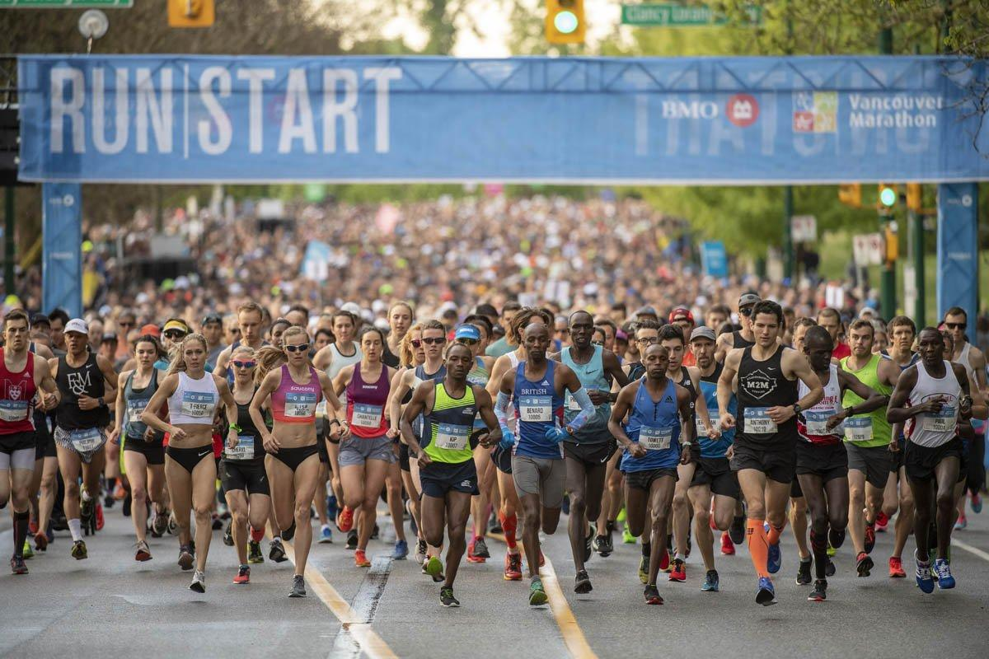
Background
Doing exercise has become a trend,It is a comprehensive physical fitness effect on our body.
exercise our heart
increase blood circulation
relax to relieve pressure
Notes:
Austen

Slide 3
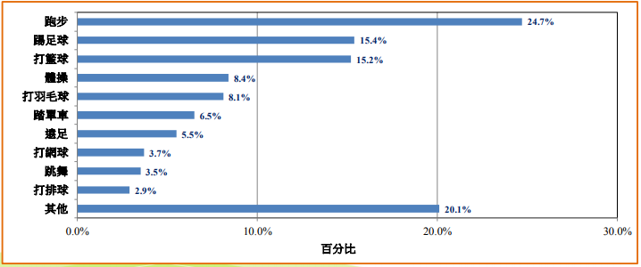
Background
A research from Centre for Health Protection in 2016 point out that the majority of people get hurt from sport is running
The most vulnerable sport in 2017
(Resource: Centre for Health Protection)
Resource: https://www.theguardian.com/football/2018/jun/20/england-world-cup-2018-gareth-southgate-shoulder
Notes:
Austen

Slide 4
Wrong Posture Effect
Knee joint
Stimulate the calf muscles and form the radish legs
The wrong posture will let you Slow down
Posterior neck pain
Notes:
Ho

Slide 5
Project Objective
To develop an application which can motion capture
Motion capture, cameras and lighting are specifically configured to simply observe and track keypoint.
It will compare with professional posture and provide correct posture to the user.
Real-time camera, video, photo to scan people skeleton and calculate the angle.
Offer another function to display and scan the professional running posture with the skeleton
Use AI to analyze the actions and show the skeleton pose to let users see the actions clearly
Offer suggestion to the user
After analyze and scan the actions, It will offer the suggestion to the user about improve the action
Notes:
Dennis

Slide 6
Solution (AI)
Detect user pose
Photo → Skeleton photo
Analyze user pose
Calculate body action angle
Show analytical reliability
Show angle and give suggestion
Display the angles
give suggestion to user
Show line chart of Gait characteristics (real-time)
Notes:
Issac

Slide 7
OpenPose VS Posenet
Advantage of OpenPose:
Accuracy (single)
High Speed
Advantage of Posenet:
Accuracy (multiple)
Reason of choosing OpenPose:
accuracy is more important
Real-time detection need high speed to calculate skeleton.
Notes:
Austen

Slide 8
OpenPose Introduction
A library for real-time multi-person keypoint detection and multi-threading
OpenPose represents the first real-time system to jointly detect human body, hand and facial keypoints (in total 130 keypoints) on single images. In addition, the system computational performance on body keypoint estimation is changeless to the number of detected people in the image.
Bottom-up approaches - offer robustness and have the potential to decouple runtime complexity from the number of people in the image.
Notes:
Chu ---- Representation of association scores via Part Affinity Fields (PAFs), a set of 2D vector fields that encode the location and orientation of limbs over the image domain

Slide 9
OpenPose principle
5 steps:
input a color image of size h x w and produces
After a backbone(vggNet)
After at least two stages, each stage has 2 branches ---One is used to detect heatmap; one is used to detect vectmap
Each keypoint pair was detected
PAFs will correctly connect each keypoint
Notes:
chu

Slide 10
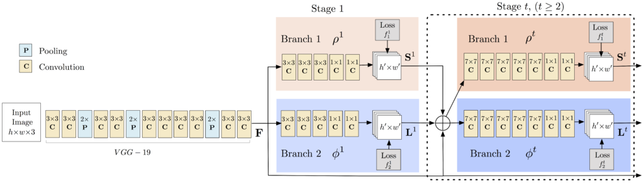
OpenPose principle
Notes:
chu

Slide 11
Function
For the Account
Register
Login
Profile
Single login function
Profile with Health Kit
Append function
Sport record
the line chair of Aait characteristics
HealthKit about steps, walk and run distance
For the Main Function
Input photo and scan skeleton function
Real-time scan skeleton function
Pose analysis
Give suggestion
Analysis the reliability
Calculate the human body skeleton joint angle
Notes:
Ho

Slide 12
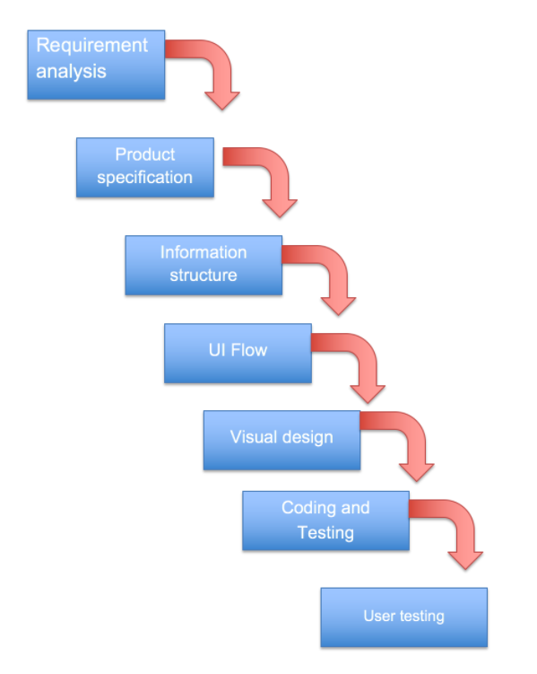
Analysis
Requirement Analysis
Product Specification
Information Structure
User Interface Flow
User interface Flow
Visual Design
Notes:
Ho

Slide 13
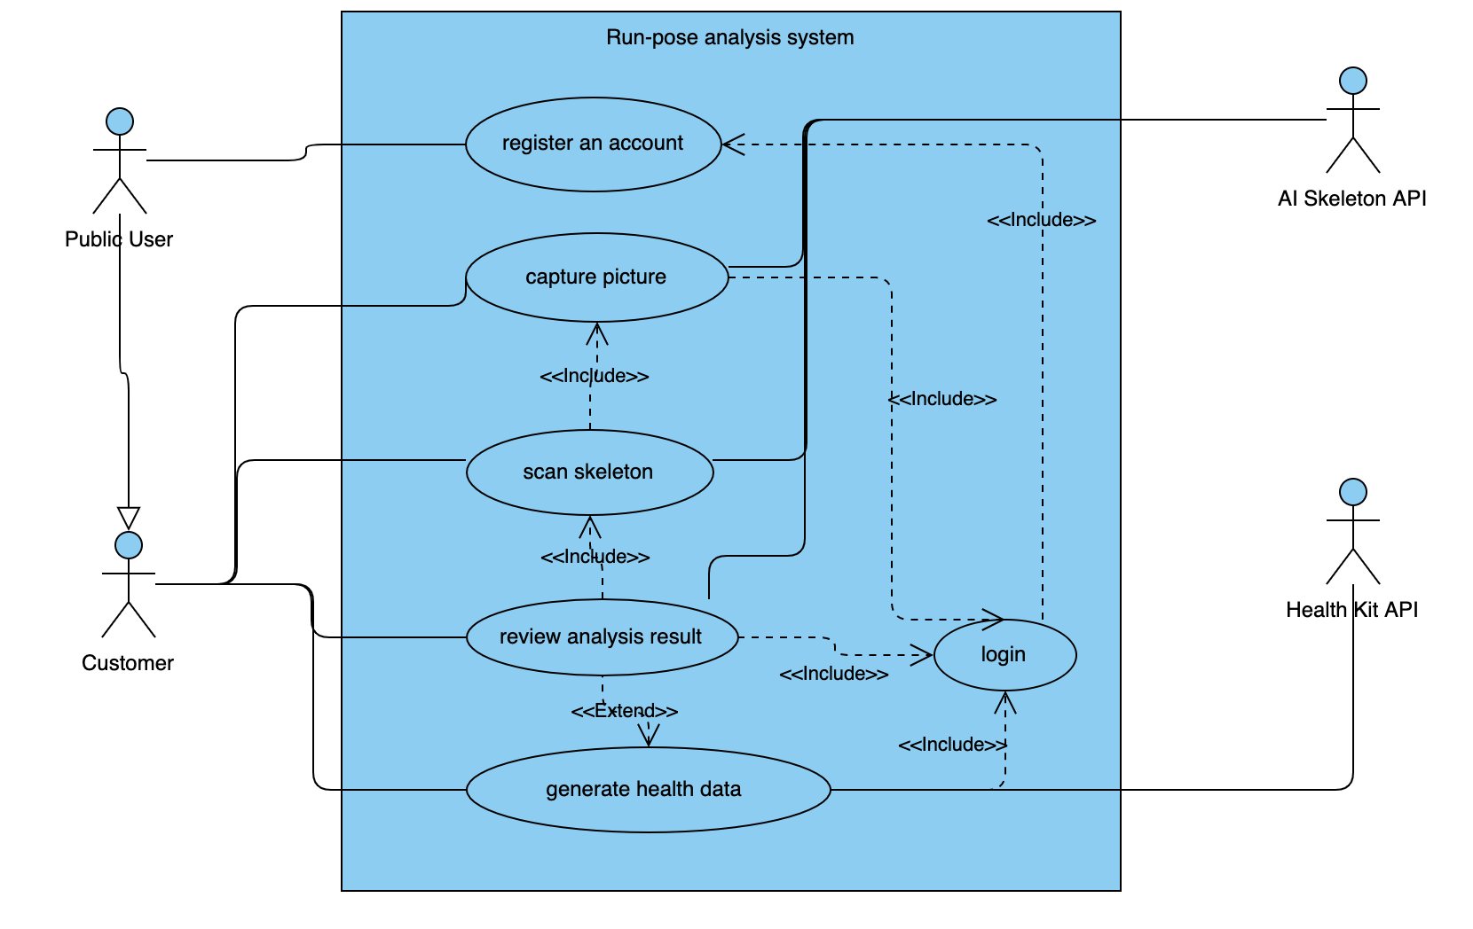
Design Diagrams
Use Case
Actor
Public user
Customer
AI Skeleton
HealthKit API
Use Case
Register an account
Capture Picture
Scan skeleton
Review analysis result
Search a list of record
Generate health data
Notes:
Chu
public user register an account to become the customer, and then, they can choose to capture pictures or scan skeleton by real-time to analysis the result, of course, they also review analysis result. Besides, the customer does exercise that will generate health data to help them.

Slide 14
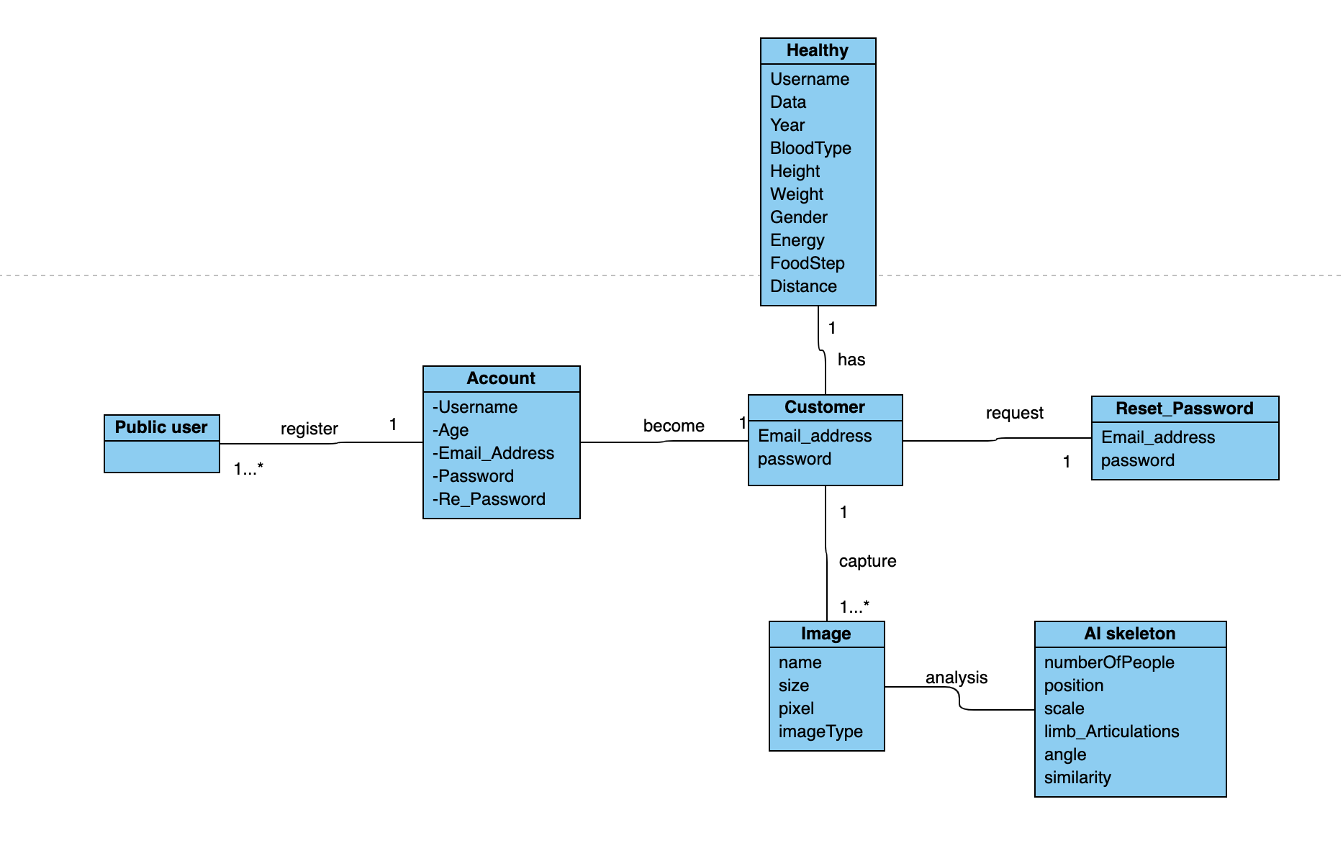
Design Diagrams
Class Diagram
Class
Public user
Account
customer
Image
AI skeleton
Reset_Password
HealthKit
Notes:
Chu

Slide 15
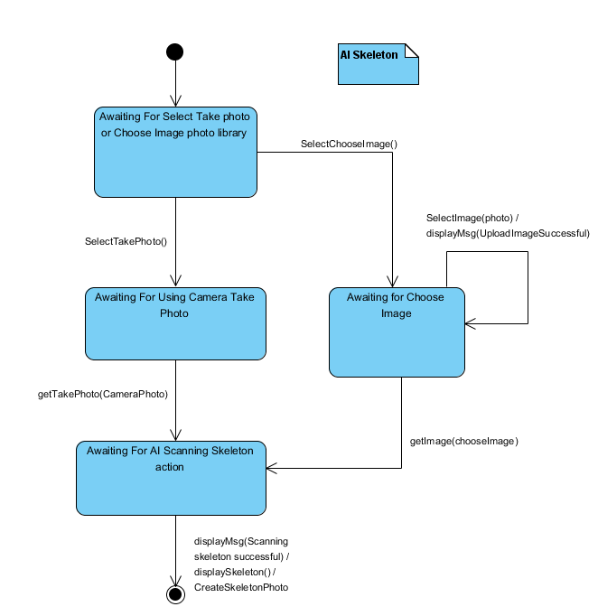
Design Diagrams
State Diagram
For the core technologies of AI scanning Skeleton function（Take Photo)
Notes:
Dennis

Slide 16
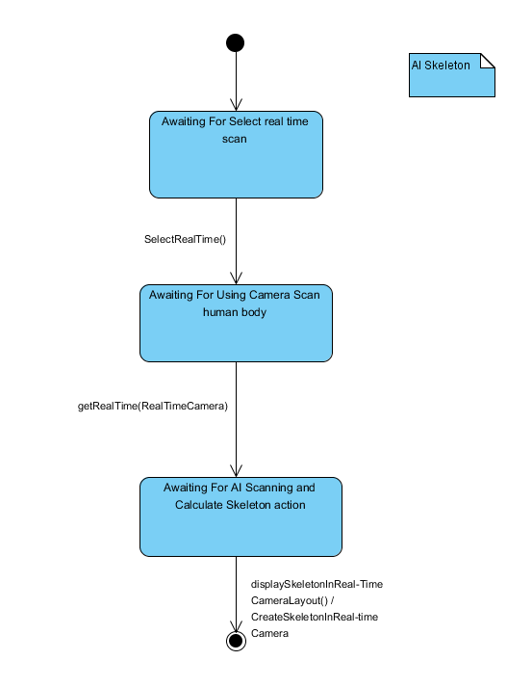
Design Diagrams
State Diagram
For the core technologies of AI scanning Skeleton function (Real-time)
Notes:
Dennis

Slide 17
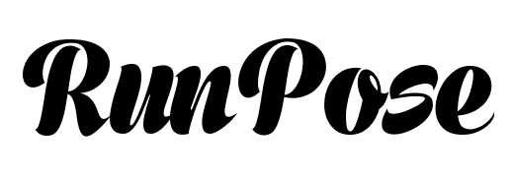

Summary of result
Final outcome
Build platform
- Registration
- Login
- Read Real time
- HealthKit
- Read picture
- Record List
Show skeleton,
Show anaylsis result,
Show suggestion
Calculate the angle of the key limb
Generate the line charts of gait characteristics
Improvements
provide more analysis of the other body part
Use obvious suggestion instead of text advice

Slide 18
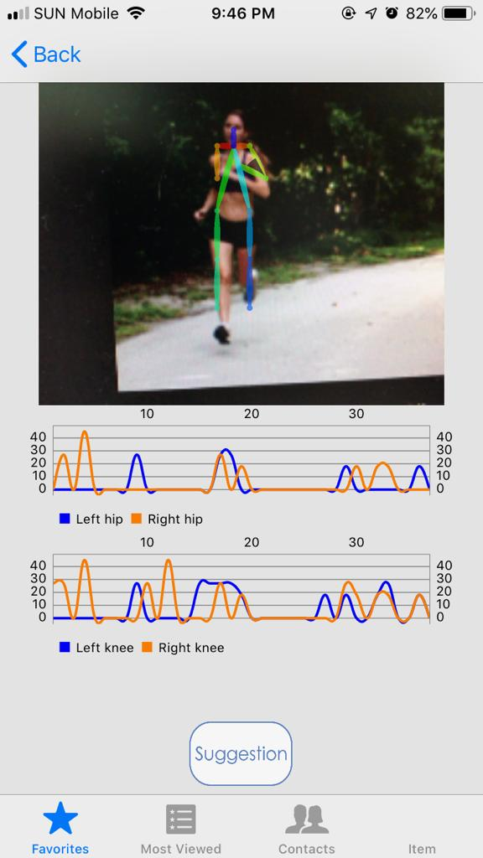
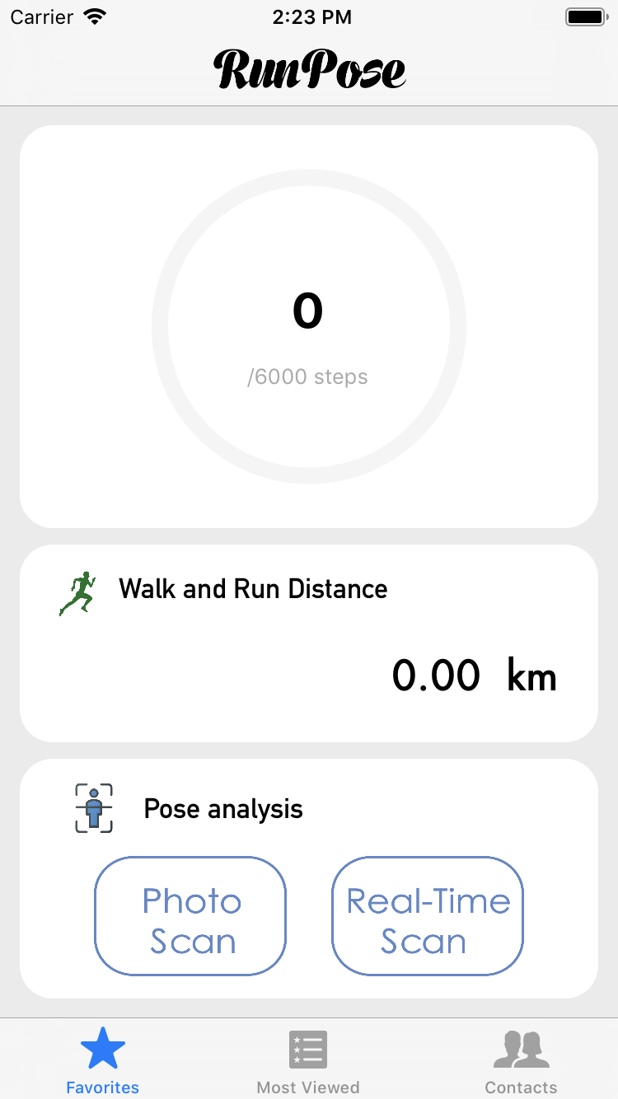
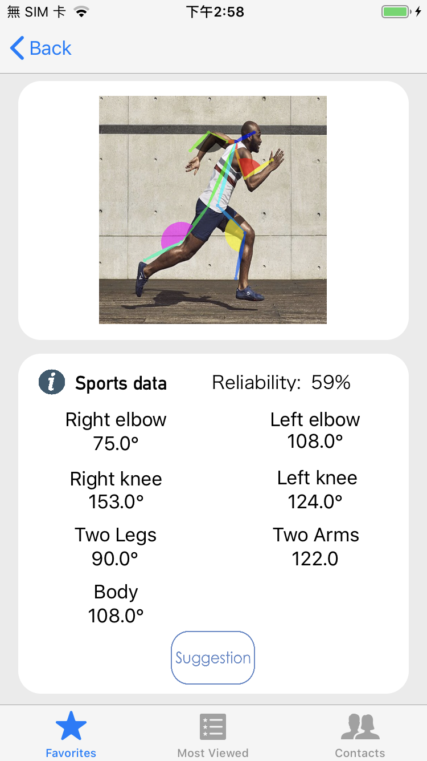
Demonstration Time

Slide 19
End

Slide 20
Q&A TIme

